Slide 1
Fitness Classification with Machine Learning
Done by:-Ahmed Shoeib

Slide 2
ML Workflow
01
02
03
04
05
06
Define the problem and assemble the dataset
A model that overfits
Measure of success
A model that does better than a baseline
Evaluation protocol
Data preparation

Slide 3
01
Define the problem and assemble the dataset

Slide 4
Define the problem and assemble the dataset
Define the problem
assemble the dataset
Synthetic dataset from Kaggle
Features: Age, Height, Weight, Gender, Exercise Duration, Heart Rate Target: is_fit (0 = Not Fit, 1 = Fit)
Goal: Predict whether a person is Fit or Not Fit
Problem type: Binary Classification
Notes:
تصنيف الأشخاص إلى Fit أو Not Fit بناءً على مجموعة من الخصائص الصحية ونمط الحياة

Slide 5
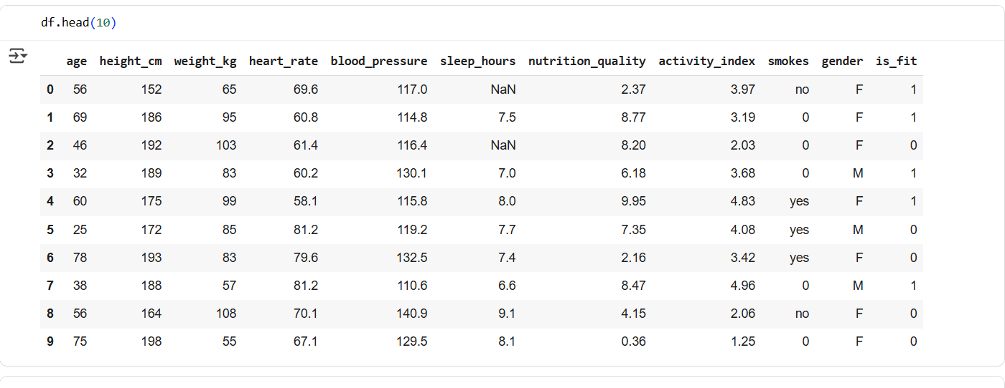

Slide 6
02
A model that overfits

Slide 7
A model that overfits
Overfitting happens when a model memorizes the training data instead of learning general patterns.
In our project, the first model showed:
Very high accuracy on training data
Much lower accuracy on test data
Overfitting is a common problem in ML and requires solutions such as regularization, cross-validation, or simpler models.

Slide 8
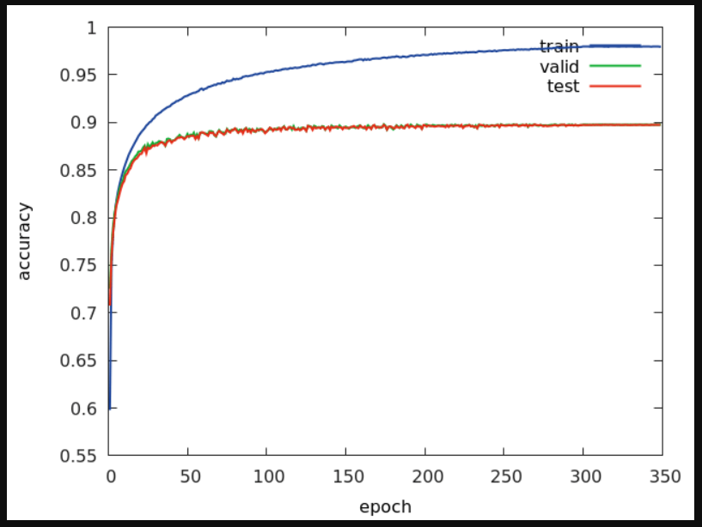

Slide 9
How we addressed Overfitting
Logistic Regression
Used simpler models
Decision Tree, Random Forest
Tried tree-based models
Solutions
Train/Test split to check generalization
Applied proper evaluation protocol
improved stability and avoided feature dominance
Used scaling and preprocessing

Slide 10
03
Measure of success

Slide 11
Measure of success
Success means the model can accurately predict fitness status for unseen individuals.
We use evaluation metrics rather than only looking at training accuracy.
Metrics chosen for projects:
Accuracy – overall percentage of correct predictions.
Precision – how many predicted Fit are actually Fit.
Recall – how many actual Fit were correctly predicted.
F1-score – balance between precision and recall.
The main goal is to build a model that performs better than a baseline and generalizes well.
Notes:
F1-score: بيوازن بين الاثنين بحيث يكون عندك توازن بين عدم تفويت الحالات الإيجابية (Recall) والدقة في التوقعات (Precision).

Slide 12
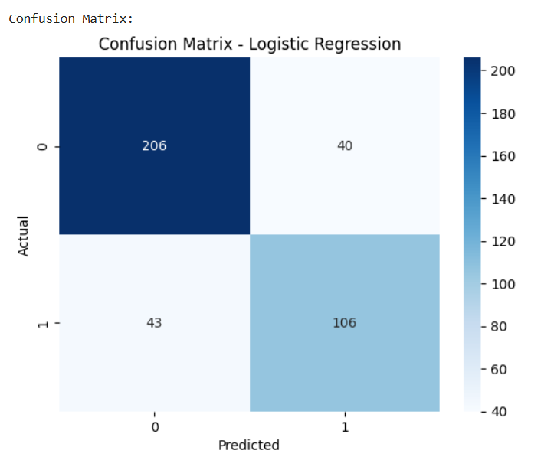

Slide 13
04
Evaluation protocol

Slide 14
Evaluation protocol
The dataset was divided into Training set (80%) and Testing set (20%).
The model was trained only on the training set.
The test set remained unseen during training and was used only for evaluation.
This ensures the model can generalize to new data instead of memorizing the training data.
Cross-validation can be applied for more reliable evaluation.
Notes:
Y3ni ymn3 overfitting لما نقسم الداتا بس لمجموعة تدريب (Training) واختبار (Test)، أحيانًا الأداء على تقسيمة واحدة ممكن يكون صدفة مش حقيقي.
Cross-validation بيحل المشكلة دي عن طريق تقسيم الداتا لأجزاء صغيرة

Slide 15
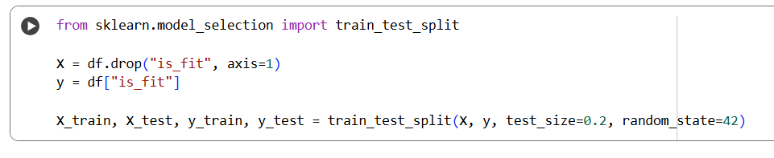
We applied an 80/20 train-test split to ensure fair evaluation. The training set is used to build the model, while the test set is kept unseen to measure generalization.

Slide 16
05
Data preparation

Slide 17
Data preparation
Checked dataset quality → no missing values.
Encoded categorical feature: Gender (Male = 0, Female = 1).
Scaled numerical features: Age, Height, Weight, Heart Rate (StandardScaler).
Feature engineering: created BMI = Weight / Height².
Ensured the data is ready for modeling and fair evaluation.

Slide 18
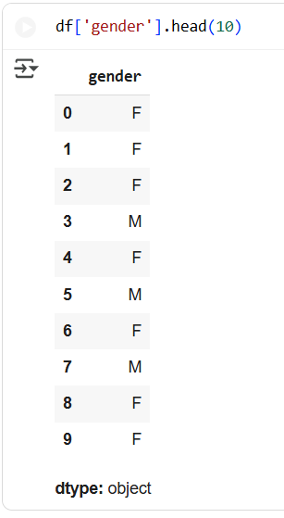
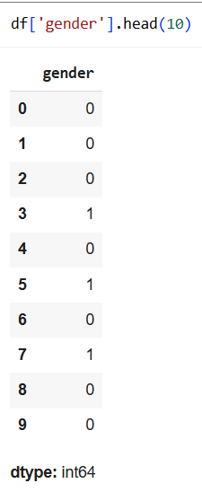
Label Encoding

Slide 19
06
A model that does better than a baseline

Slide 20
A model that does better than a baseline
We trained 4 models: Logistic Regression, Random Forest, SVM, and Naive Bayes.
All models performed better than the baseline accuracy.
We compare their performance using accuracy scores.

Slide 21
Models Better than Baseline
Simple model that predicts fit/unfit using a straight-line boundary.
Logistic Regression
Combines many trees to capture complex patterns and improve accuracy.
Random Forest
Models
Finds the best boundary between classes, works well with high-dimensional data.
Supervised Learning Algorithm(SVM)
Probabilistic model assuming feature independence, fast and simple.
Naive Bayes
Notes:
Logistic regression de classification algorithm not regression fokak mn esmaha wlaw probability bta3 elfeatures>0.5 predict class 1 works well with binary outcomes random forest bt combine many models(decision tree) ashan t3ml better prediction w momken nstkhdmha ka classification:takes majority vote from all trees w ka regression:averages the prediction w kwysa lel non linear data w reduce overfitting SVM bt3ml best boundary(hyperplane) ashan y2asem ben el fit w el not fit b the best dividing line Naïve bayes by3tmd en el features independent yaani malhomsh 3elaka bb3d w da msh helw gher ma3 small datasets

Slide 22
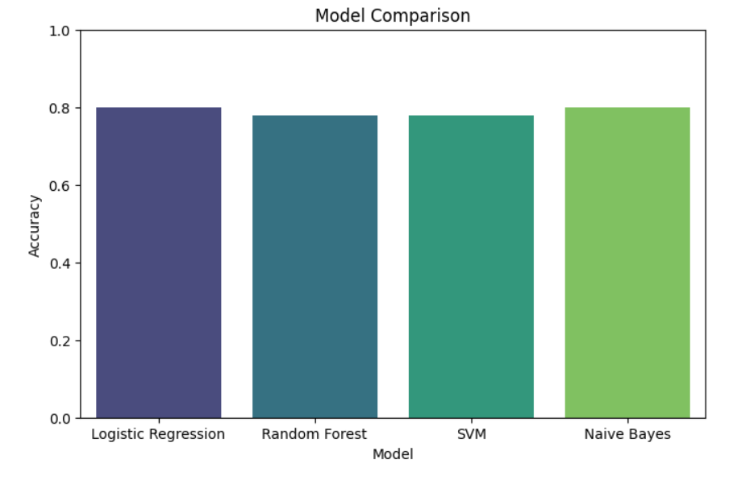

Slide 23
Conclusion
We followed 6 steps to build a machine learning project to predict fitness. We prepared the data, trained multiple models, and evaluated them. Among all models, Naive Bayes achieved the best accuracy for our dataset, showing that simple probabilistic models can work very well.

Slide 24
Thank You.

